Slide 1

Project Review - 2
on
IOT BASED SMART SECURITY SOLUTION FOR UNIQUE AUTHENTICATION
BY
Mili Chaturvedi (RA1911004010072)
Samarpan Das (RA1911004010074)
Matura Ganesh (RA1911004010113)
Under the Guidance of
Mrs. A. Bhavani
Assistant Professor, Department of ECE

Slide 2
INDEX
TOPIC
ABSTRACT
OBJECTIVE
PROBLEM STATEMENT
LITERATURE SURVEY
NOVELTY
METHODOLOGY
SYSTEM ARCHITECTURE
HARDWARE / SOFTWARE SPECIFICATION
RESEARCH PROGRESS
RESULT
WORKPLAN
APPLICATION
CONCLUSION
FUTURE WORK
PUBLICATION STATUS
REFERENCES
2

Slide 3
ABSTRACT
In this project we present a Smart Security for Unique Authentication.
A specific data acquisition IOT system is to be constructed to capture the fingerprint, iris image.
An efficient algorithm is to be presented to process the acquitted data and determine if it matches with an authorised user in the database.
A database will be established to examine the performance of the proposed system and facilitate analytical evaluations by the organisation.
In case of breaches, the organisation and the authorised user are to be notified via Alarm.
3

Slide 4
OBJECTIVE
To create a database and system for user registration.
To implement a hardware setup to capture iris image, face image and fingerprint image of the guest.
To implement a software system to match the captured details with existing details of the authorised user in the database.
To write and test machine learning and deep learning models to check which performs best with the CASIA-1 dataset for Iris recognition.
To keep record of the number of entries, successful or failed transactions, a database will be created and tested with the hardware.
4

Slide 5
PROBLEM STATEMENT
Real-world worries about the safety of material assets and identity theft are becoming more prevalent each day.
There are already mechanisms in place, such as pins to punch ins to access a secure workplace or biological patterns to authenticate or keys for locker systems.
However, these existing models have issues such as forgotten pin, carrying a physical device (key or RFID card) which could be lost.
Our three factor authentication system irradiates the need to carry any physical chip - based device by the user or the need for the user to remember a pin / password, thus reducing chances of human error.
5

Slide 6
LITERATURE SURVEY
Author | Paper | References
X. Yang, S. Yang, J. Liu, C. Wang, Y. Chen and N. Saxena, | "Enabling Finger-Touch-Based Mobile User Authentication via Physical Vibrations on IoT Devices," in IEEE Transactions on Mobile Computing, vol. 21, no. 10, pp. 3565-3580, 1 Oct. 2022, doi: 10.1109/TMC.2021.3057083. | In this paper, we propose a system that implements the idea of low-cost low-power tangible user authentication beyond touch screens to any solid surface to support smart access applications (e.g., apartment entrances, vehicle doors, or smart appliances).
D. Breitenbacher, I. Homoliak, Y. L. Aung, Y. Elovici and N. O. Tippenhauer, | HADES-IoT: A Practical and Effective Host-Based Anomaly Detection System for IoT Devices (Extended Version)," in IEEE Internet of Things Journal, vol. 9, no. 12, pp. 9640-9658, 15 June15, 2022, doi: 10.1109/JIOT.2021.3135789 | HADES-IoT provides tamper-proof protection and can be deployed on a wide range of Linux-based IoT devices. HADES-IoT’s main advantage is its low overhead, making it suitable for Linux-based IoT devices where state-of-the-art security solutions are infeasible due to their high-performance demands.
6

Slide 7
LITERATURE SURVEY
Author | Paper | References
C. Choi and J. Choi | "Ontology-Based Security Context Reasoning for Power IoT-Cloud Security Service," in IEEE Access, vol. 7, pp. 110510-110517, 2019, doi: 10.1109/ACCESS.2019.2933859. | The paper presents an appropriate power IoT-Cloud security service framework that can be used in a power IoT-Cloud environment. In addition, a security mechanism that can be efficiently operated in such an environment is implemented.
W. Iqbal, H. Abbas, M. Daneshmand, B. Rauf and Y. A. Bangash | "An In-Depth Analysis of IoT Security Requirements, Challenges, and Their Countermeasures via Software-Defined Security," in IEEE Internet of Things Journal, vol. 7, no. 10, pp. 10250-10276, Oct. 2020, doi: 10.1109/JIOT.2020.2997651. | This article thoroughly reviews the threats, security requirements, challenges, and the attack vectors pertinent to IoT networks. Based on the gap analysis, a novel paradigm that combines a network-based deployment of IoT architecture through software-defined networking (SDN) is proposed.
J. Srinivas, A. K. Das, M. Wazid and A. V. Vasilakos | "Designing Secure User Authentication Protocol for Big Data Collection in IoT-Based Intelligent Transportation System," in IEEE Internet of Things Journal, vol. 8, no. 9, pp. 7727-7744, 1 May 1, 2021, doi: 10.1109/JIOT.2020.3040938. | The paper proposes to design a new three-factor user authentication scheme, called UAP-BCIoT, which relies on elliptic-curve cryptography (ECC). The mutual authentication between the user and an IoT device happens via the semi-trusted cloud-gateway.
7

Slide 8
NOVELTY
The project aims to propose an improved version of existing security systems by increasing the number of layers in authentication.
The addition of IRIS recognition along with existing systems of fingerprint.
Implement and identify efficient machine learning and deep learning model against the target dataset and find which performs best by projecting the accuracy scores.
8

Slide 9
METHODOLOGY
CREATE FINGERPRINT, FACE AND IRIS DATABASE
CHECK IF MATCHING METRIC FOUND IN DATABASE
SCAN FINGERPRINT
SCAN IRIS
COUNT THE UPDATE AND INCLUDE TIME STAMP
IN CASE OF MISMATCH
CREATE A DATABASE OF USER BIOMETRICS WITH IRIS SCAN, FINGERPRINT SCAN ALONG WITH OTP
ALLOW ACCESS TO LOCKER, ADD COUNT UPDATE AND TIMESTAMP IN DATABASE
ALARM BUZZER IS SET ON
Fig. 1: Proposed Workflow
9

Slide 10
SYSTEM ARCHITECTURE (PROPOSED)
A database for account details along with corresponding iris and fingerprint encoding is created.
In the first step fingerprint scanning is done.
If it matches, move onto iris scanning.
Once the iris impression matches with the imprint in the database, update the database.
A time stamp is also included for keeping record for future requirements.
If either of the fingerprint scanning or the iris scanning fails, the authorised personnel is notified via Alarm.
The database is updated with the failed attempt information.
10

Slide 11
HARDWARE / SOFTWARE SPECIFICATION
SOFTWARE
Arduino IDE
Anaconda IDE
Google Colaboratory
HARDWARE
Arduino Pro Mini
R307 Fingerprint Scanner
Camera module
Relay
Solenoid Lock
Raspberry Pi 4 Model B
11

Slide 12
RESEARCH PROGRESS
Literature Survey: We went through relevant papers related to IOT based security solutions, IOT server side storage, machine learning models working on eye image recognition.
Interfacing of the hardware and software for fingerprint scanner completed.
2 machine learning models were compared for their performance against the CASIA dataset.
2 deep learning models were compared for their performance against the CASIA dataset.
Comparing the best performing Deep learning model versus the best performing machine learning model in terms of accuracy scores.
12

Slide 13
RESULTS
Epoch Accuracy data for Inception Neural Network V1
Epoch | Loss | Accuracy | Validation loss | Validation accuracy
1/50 | 0.539 | 0.848 | 0.3475 | 0.913
10/50 | 0.662 | 0.898 | 0.332 | 0.919
20/50 | 0.797 | 0.978 | 0.3118 | 0.927
30/50 | 0.422 | 0.987 | 0.408 | 0.926
40/50 | 0.329 | 0.990 | 0.454 | 0.921
50/50 | 0.019 | 0.993 | 0.387 | 0.928
13

Slide 14
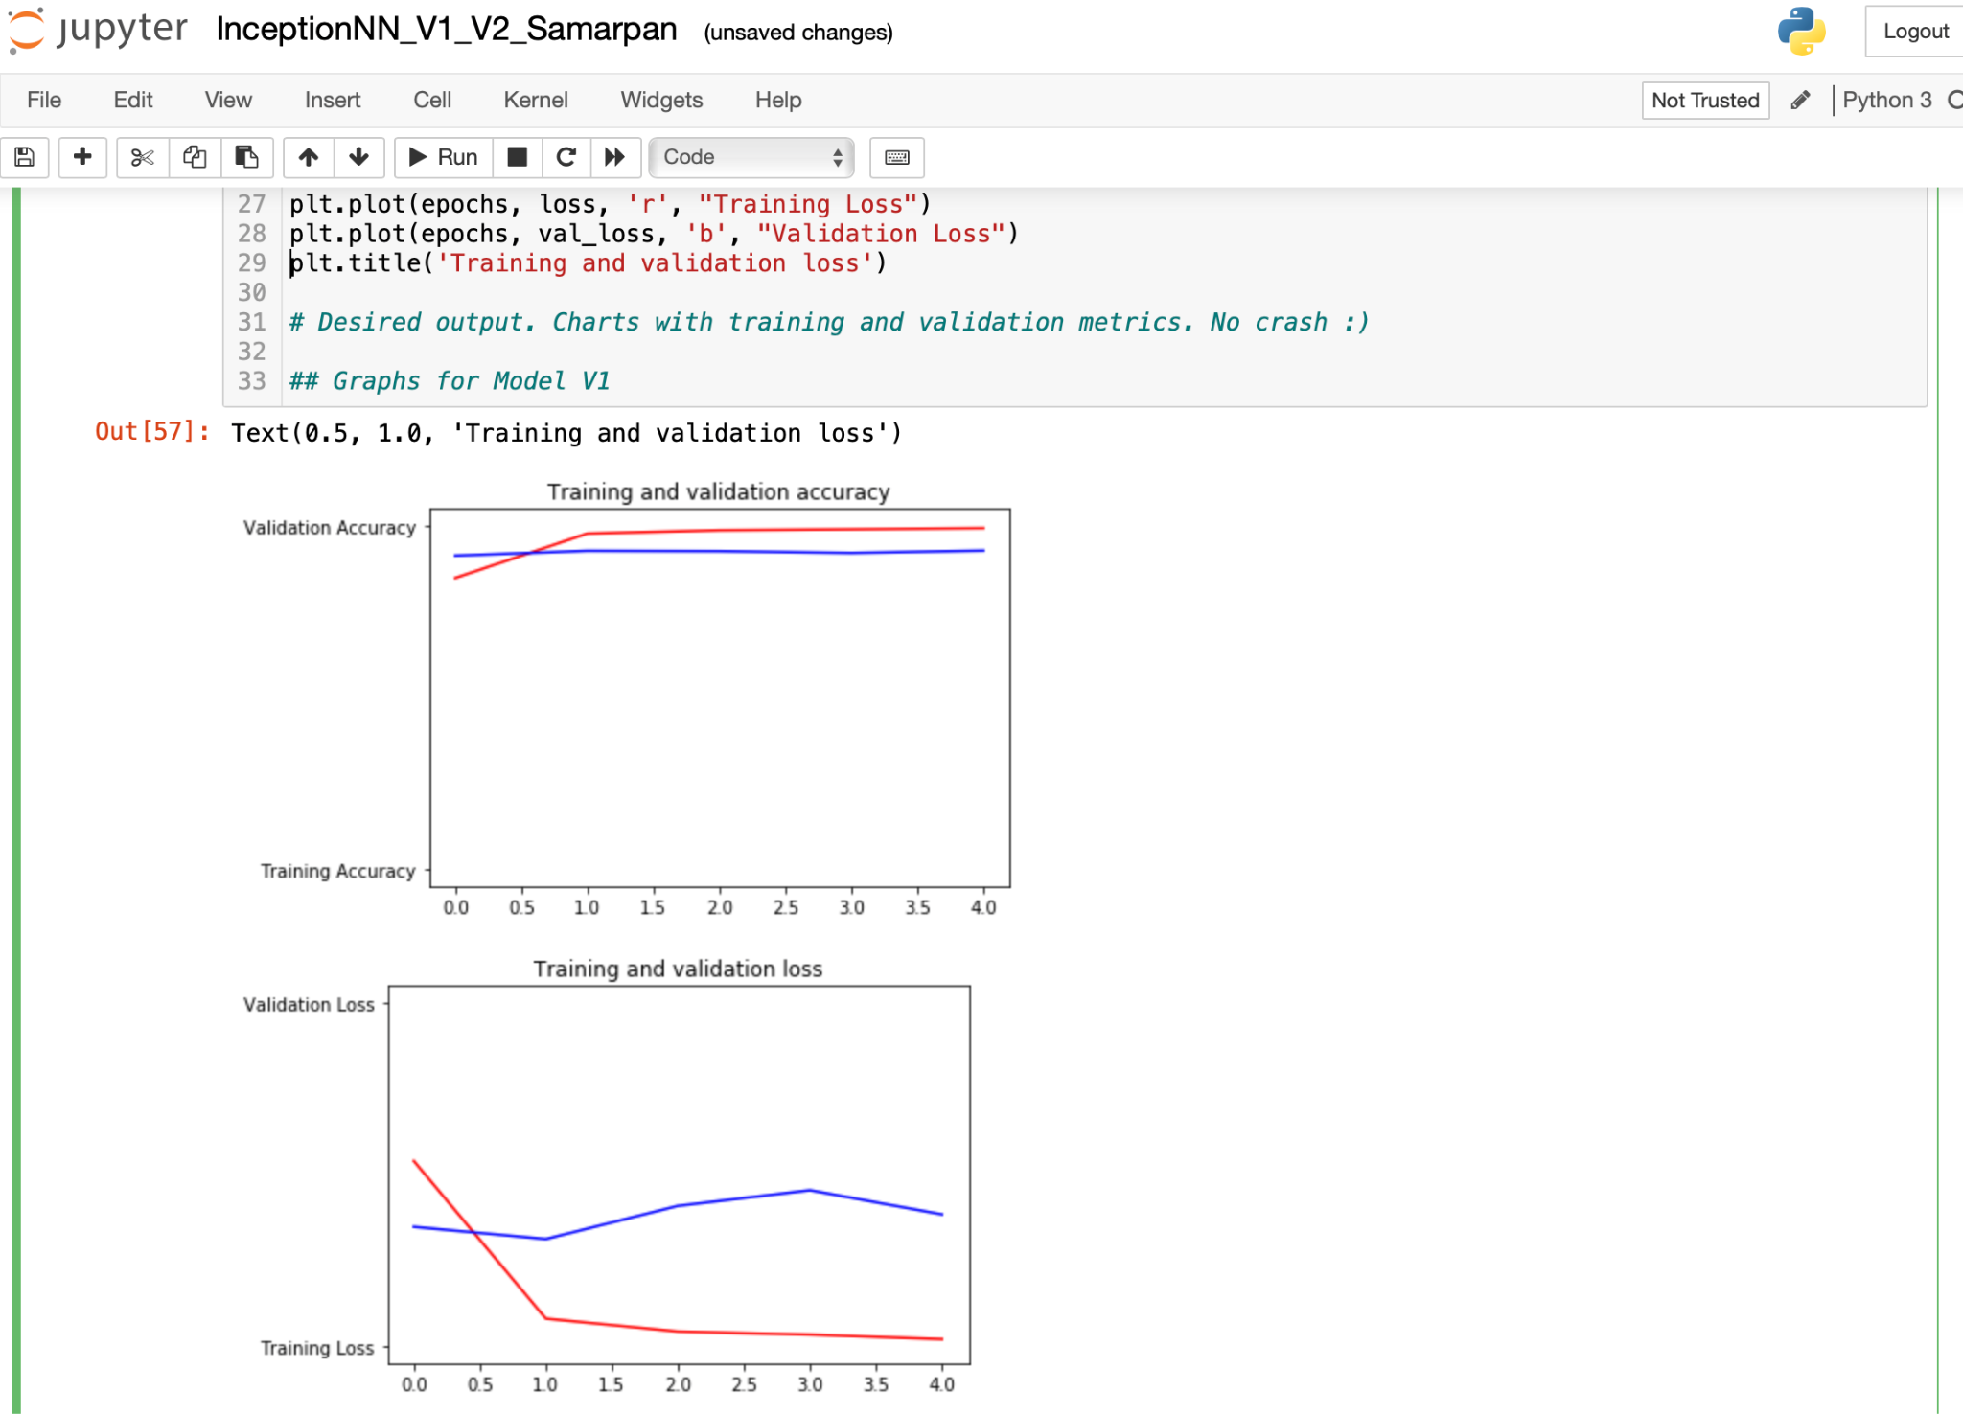
RESULTS
Loss vs Accuracy comparison for Inception Neural Network V1
14

Slide 15
RESULTS
Epoch Accuracy data for Inception Neural Network V2
Epoch | Loss | Accuracy | Validation loss | Validation accuracy
1/50 | 0.8508 | 0.7522 | 0.3478 | 0.8957
10/50 | 0.0661 | 0.9794 | 0.2007 | 0.9459
20/50 | 0.0325 | 0.9902 | 0.0.2518 | 0.9459
30/50 | 0.0271 | 0.9915 | 0.2128 | 0.9454
40/50 | 0.0240 | 0.9937 | 0.2035 | 0.9666
50/50 | 0.0238 | 0.9946 | 0.2259 | 0.9577
15

Slide 16
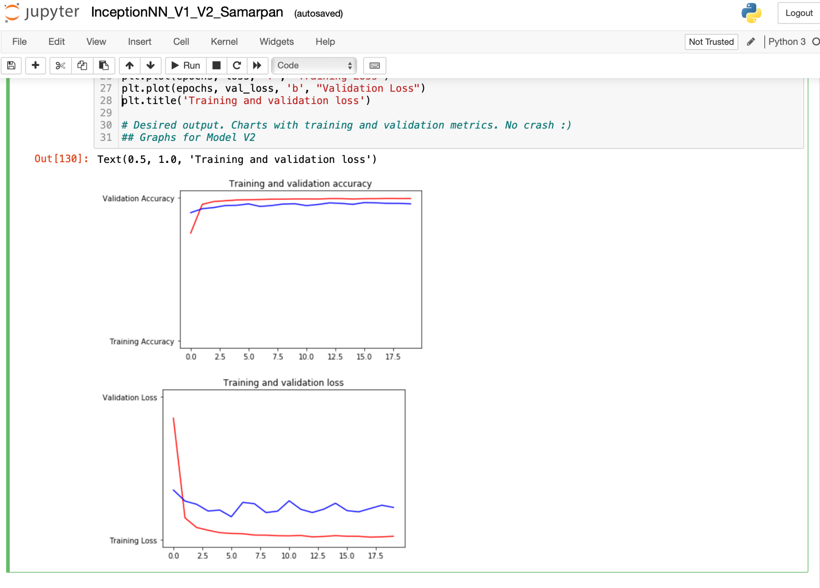
RESULTS
Loss vs Accuracy comparison for Inception Neural Network V2
16

Slide 17
RESULTS
Epoch Accuracy data for Support Vector Machine
Epoch | Loss | Accuracy | Validation loss | Validation accuracy
1/50 | 0.6101 | 0.7993 | 1.9106 | 0.7125
10/50 | 0.0457 | 0.9834 | 0.8488 | 0.8303
20/50 | 0.0106 | 0.9961 | 0.6437 | 0.8499
30/50 | 0.0085 | 0.9971 | 0.9031 | 0.8210
40/50 | 0.0049 | 0.9977 | 0.8564 | 0.8395
50/50 | 0.0031 | 0.9977 | 0.9171 | 0.8314
17

Slide 18
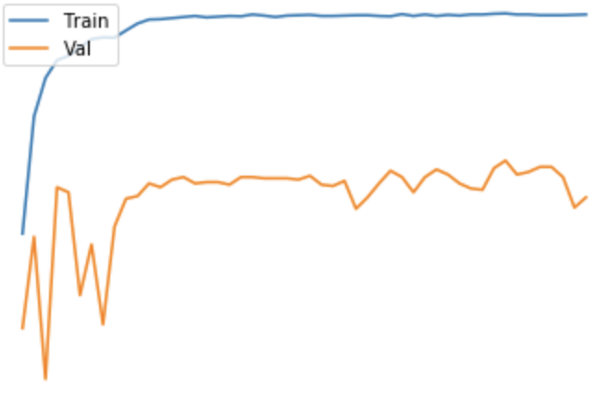
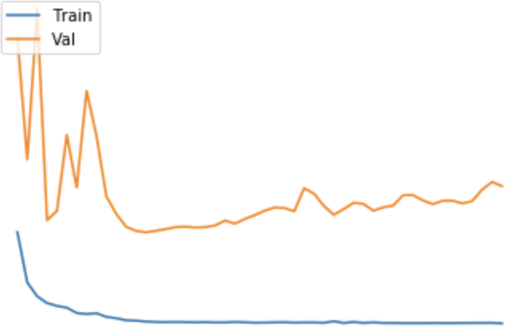
RESULTS
Loss vs Accuracy comparison for Support Vector Machine
Accuracy score
Loss score
No. of epochs
No. of epochs
Training Accuracy vs Validation Accuracy
Training Loss vs Validation Loss
18

Slide 19
RESULTS
Epoch Accuracy data for Decision Tree Classifier
Epoch | Loss | Accuracy | Validation loss | Validation accuracy
1/50 | 2.4870 | 0.3895 | 2.6569 | 0.4366
10/50 | 0.0892 | 0.9742 | 1.5141 | 0.6598
20/50 | 0.0288 | 0.9916 | 1.6755 | 0.6613
30/50 | 0.0174 | 0.9943 | 1.8187 | 0.6593
40/50 | 0.0146 | 0.9953 | 2.0363 | 0.6481
50/50 | 0.0104 | 0.9964 | 2.1411 | 0.6270
19

Slide 20
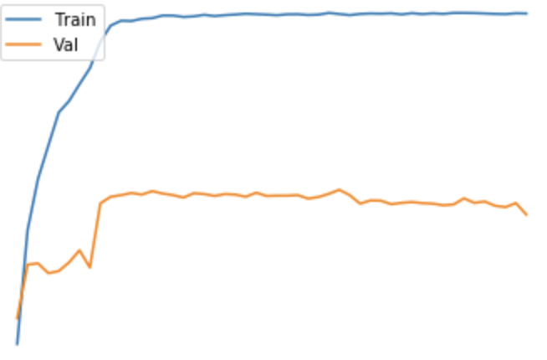
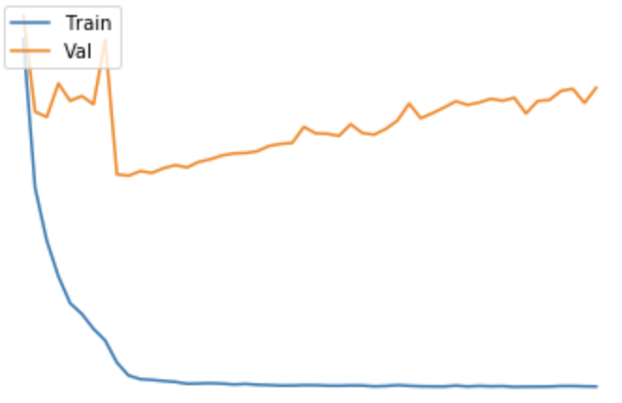
RESULTS
Loss vs Accuracy comparison for Decision Tree Classifier
Accuracy score
Loss score
No. of epochs
No. of epochs
Training Accuracy vs Validation Accuracy
Training Loss vs Validation Loss
20

Slide 21
About Fingerprint Sensor
Fingerprint sensor was constructed using an Arduino, Raspberry Pi 4 Model B.
To demonstrate the results of the interfacing we have a display setup.
Arduino is used as a database vessel.
Raspberry pi 4 is used to read the database and the then display is connected to the arduino board.
First a dataset is fed to arduino and saved.
When the fingerprint matches with the saved image, the display says ‘Welcome name of the person’.
21

Slide 22
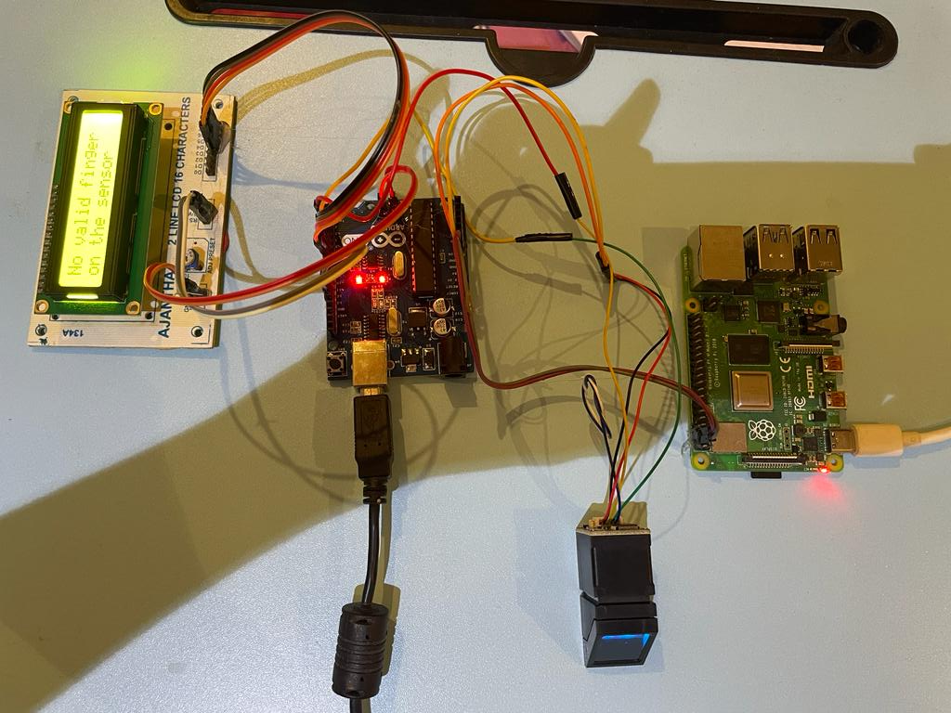
About Fingerprint Sensor
22

Slide 23
WORK PLAN (TIMELINE)
Work Segment | Review | WORK TO BE COMPLETED
OCTOBER | 0th review | Introduction About the project
NOVEMBER DECEMBER | - | Literature survey About the software
JANUARY | - | Coding in the software
FEBRUARY | 1st review | Design hardware and analysis of proposed system
MARCH | 2nd review | Testing and interfacing of all the hardware components.
APRIL - MAY | 3rd review | Finalize the interfacing of components. Complete report based on the final result analysis
23

Slide 24
APPLICATIONS
In finance sector - in banking sector for better maintenance of data of clients.
In commercial sector - this system could be installed on the server and utilised to authenticate the user so as to avoid cases of fraud.
In telecommunication sector - this could be used to keep records of users while providing them with multiple sim cards.
To authenticate / get the information of the person entering the premises of a secure office.
There could be many more applications such as in bank lockers to keep the security level to max at all times.
24

Slide 25
CONCLUSION
Implemented a Decision Tree classifier, machine learning model against the CASIA dataset and received an accuracy score of 66.2 %.
Coded the SVM machine learning model against the CASIA dataset to receive 83 % accuracy for the randomly chosen test dataset.
Implemented the Inception Neural Network version - 1, deep learning model and received an accuracy score of 92.8 %.
Implemented the Inception Neural Network version - 2, deep learning model and received an accuracy score of 95.7 %.
25

Slide 26
CONCLUSION
Hence, Deep learning algorithms work better for complex - detailed IRIS recognition purpose as compared to conventional machine learning algorithms.
Coded the fingerprint scanner system in interfaced it with the Arduino - UNO microcontroller.
Connected the fingerprint scanner and arduino board with a Raspberry pi to speed up the booting and scanning process.
26

Slide 27
FUTURE WORK
Implement and interface the finalised IRIS recognition code in the arduino board.
Select and synchronise the camera module with for IRIS recognition with the Raspberry pi module.
Create the database for user information storage.
Code and connect the hardware with the server and the database.
Interface the Fingerprint module and IRIS recognition module together and connect the both to an alarm system.
27

Slide 28
PUBLICATION STATUS
The paper is in the process of being drafted.
The title shall be, “IOT Based Smart Security Solution for Unique Authentication”.
“RAEEUCCI - 2.0” is being aimed for publishing the paper.
Link of the draft so far has been given below -
DRAFT OF RESEARCH PAPER
28

Slide 29
REFERENCES
W. Iqbal, H. Abbas, M. Daneshmand, B. Rauf and Y. A. Bangash, "An In-Depth Analysis of IoT Security Requirements, Challenges, and Their Countermeasures via Software-Defined Security," in IEEE Internet of Things Journal, vol. 7, no. 10, pp. 10250-10276, Oct. 2020, doi: 10.1109/JIOT.2020.2997651.
K. Umamaheswari and P. Mahitha, "Smart security system for door access based on unique authentication," 2021 Fifth International Conference on I-SMAC (IoT in Social, Mobile, Analytics and Cloud) (I-SMAC), Palladam, India, 2021, pp. 1474-1477, doi: 10.1109/I-SMAC52330.2021.9640855.
D. Breitenbacher, I. Homoliak, Y. L. Aung, Y. Elovici and N. O. Tippenhauer, "HADES-IoT: A Practical and Effective Host-Based Anomaly Detection System for IoT Devices (Extended Version)," in IEEE Internet of Things Journal, vol. 9, no. 12, pp. 9640-9658, 15 June15, 2022, doi: 10.1109/JIOT.2021.3135789.
29

Slide 30
REFERENCES
C. Choi and J. Choi, "Ontology-Based Security Context Reasoning for Power IoT-Cloud Security Service," in IEEE Access, vol. 7, pp. 110510-110517, 2019, doi: 10.1109/ACCESS.2019.2933859.
H. Ali, M. J. E. Salami and Wahyudi, "Iris recognition system by using support vector machines," 2008 International Conference on Computer and Communication Engineering, Kuala Lumpur, Malaysia, 2008, pp. 516-521, doi: 10.1109/ICCCE.2008.4580657.
S. S. Salve and S. P. Narote, "Iris recognition using SVM and ANN," 2016 International Conference on Wireless Communications, Signal Processing and Networking (WiSPNET), Chennai, India, 2016, pp. 474-478, doi: 10.1109/WiSPNET.2016.7566179.
30

Slide 31
REFERENCES
J. Kamat and R. Gupta, "Inception SN: An Inception based Convolutional Neural Network for Hyperspectral Image Classification," 2021 2nd Global Conference for Advancement in Technology (GCAT), Bangalore, India, 2021, pp. 1-4, doi: 10.1109/GCAT52182.2021.9587504.
Y. Watanabe, A. Nakazawa, Y. Mitsuzumi and T. Nishida, "Spatio-temporal eye contact detection combining CNN and LSTM," 2019 16th International Conference on Machine Vision Applications (MVA), Tokyo, Japan, 2019, pp. 1-7, doi: 10.23919/MVA.2019.8757989.
31

Slide 32
THANK YOU !
32

